Slide 1
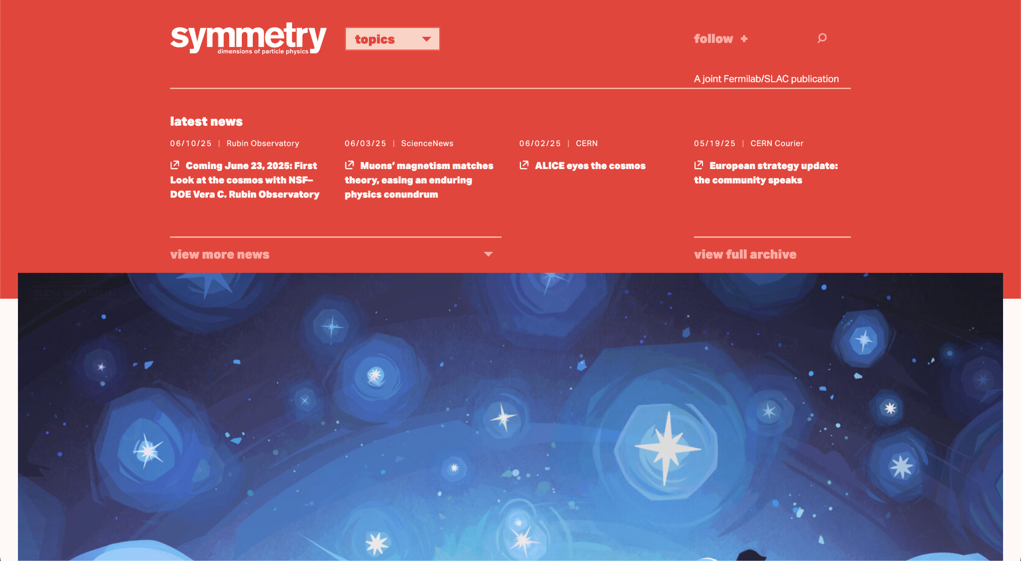
Scrollable Header
https://www.symmetrymagazine.org/

Slide 2

Sliding Sections
https://www.digitalmarmalade.co.uk/

Slide 3

Blog Content Gallery - Gradient Highlight upon hovering
https://www.digitalmarmalade.co.uk/

Slide 4
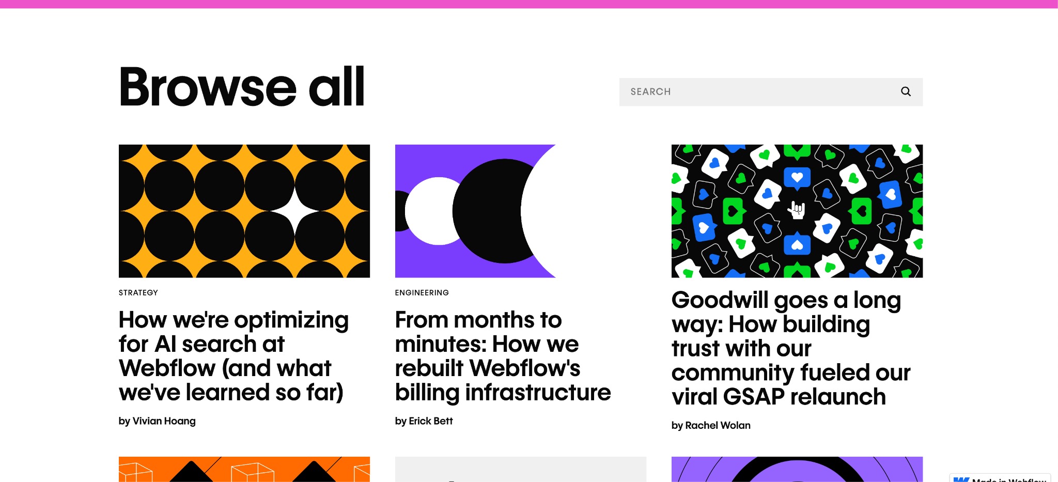
Blog Content Gallery
https://webflow.com/blog

Slide 5

Statis Section & find out more page
https://www.digitalmarmalade.co.uk/

Slide 6

Singup for newsletters & Footer
https://www.popsci.com/

Slide 7
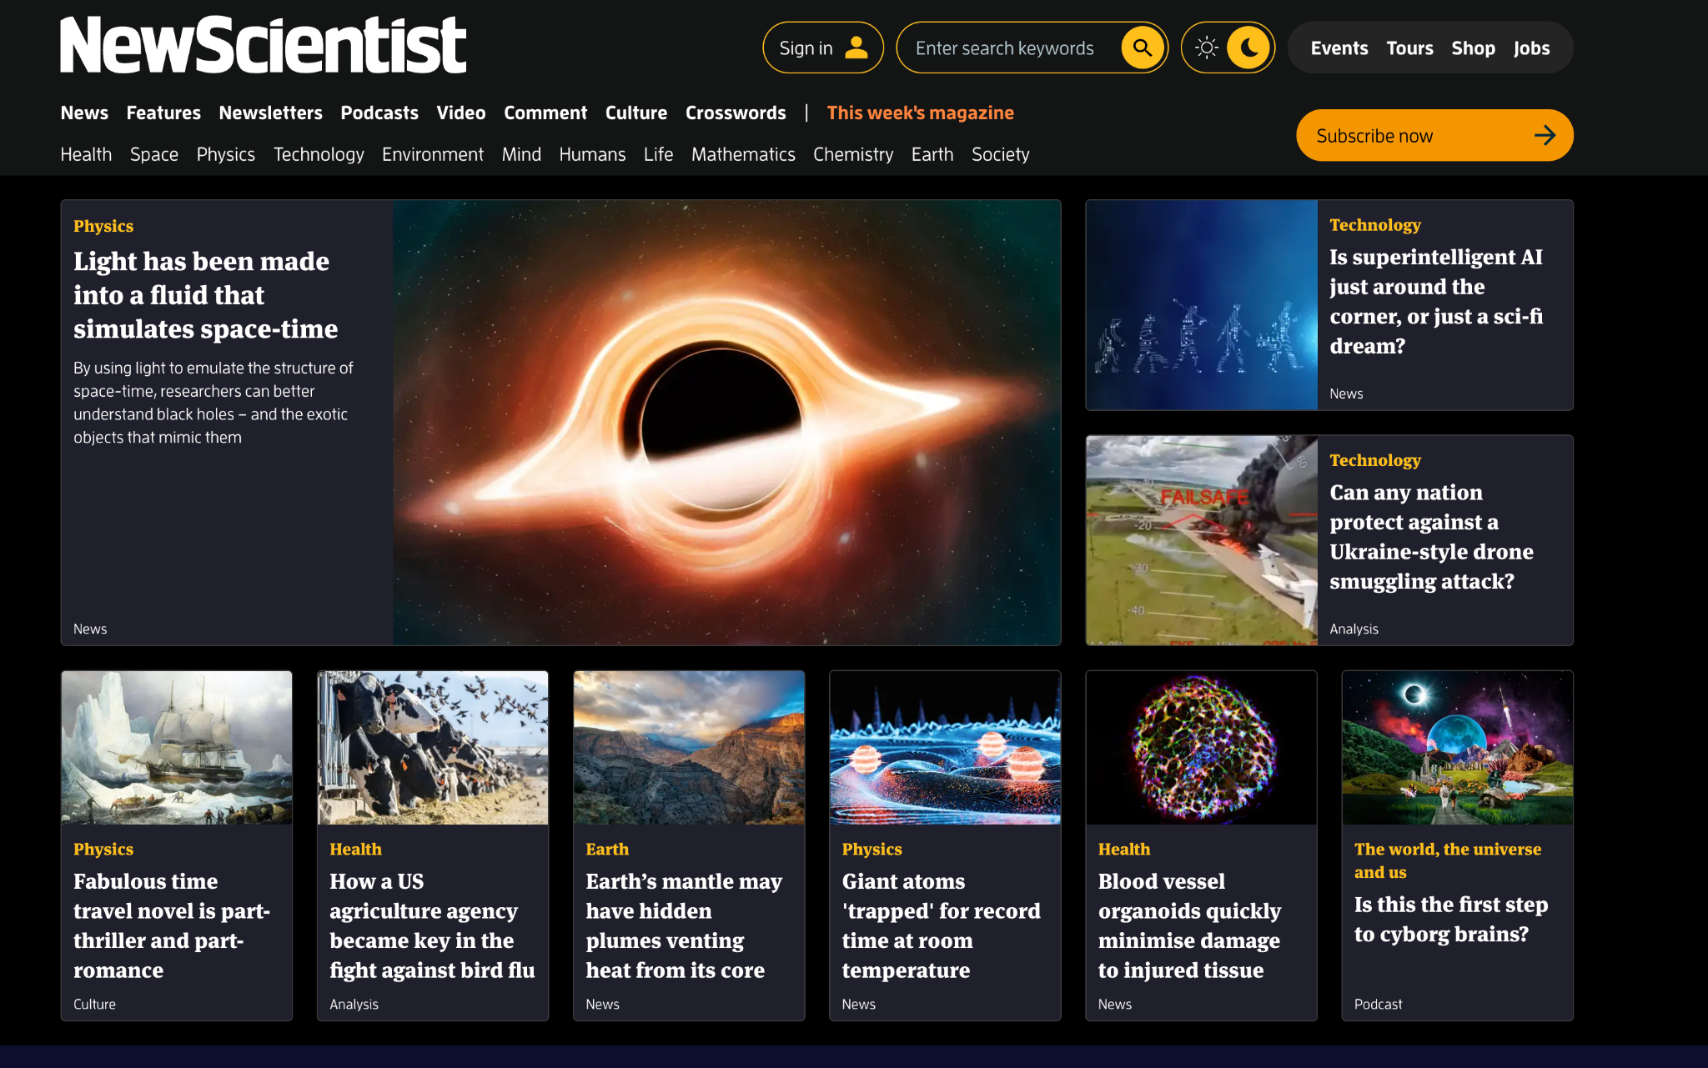
Dark/Light Mode Switch Button

